Slide 1
Microsoft Azure Machine Learning
Andrew Moll

Slide 2
What is Machine Learning?
Computing systems that become smarter with experience
“Experience” = past data + human input
“
I need our systems to think. I need them to learn and I need them to present issues and problems and anomalies to the employees, to the managers.
Adam Coffey President and CEO
WASH Laundry Systems
”
Notes:
Machine Learning is a term that is not widely understood, perhaps you think of it as artificial intelligence or robotics or any number of things. It’s helpful to start with how Microsoft thinks of machine learning. Machine learning means computers that become smarter with experience. What do we mean by experience?
Experience is past data + human input. And that past data is often huge – the quantity of data is doubling about every 18 months and that’s only increasing from here. Computers can consider far more variables than a human making the same decision.
And what do we mean by human input? Human input takes two forms – the input of the user who is either communicating that the output is what they are looking to see or not. In the case that it’s not, the machine can either self-adjust to deliver better results moving forward or the advanced analytic developer or data scientist can make those changes to the model. Let’s look at examples from our own work over many years.
WASH video:
https://www.youtube.com/watch?v=iIYU1Xfhr8g&feature=youtu.be

Slide 3
Advanced Analytics Beyond business intelligence
How can we make it happen?
Prescriptive Analytics
What will happen?
Predictive Analytics
OPTIMIZATION
FORESIGHT
Why did it happen?
VALUE
Diagnostic Analytics
What happened?
INSIGHT
Descriptive Analytics
HINDSIGHT
INFORMATION
Traditional BI
Advanced Analytics
Source: Gartner
DIFFICULTY

Slide 4
Microsoft & Machine Learning Answering questions with experience
1991
1997
2008
2009
2010
2014
2015
Microsoft Research formed
Hotmail launches
Which email is junk?
Bing maps launches
What’s the best way home?
Bing search launches
Which searches are most relevant?
Kinect launches
What does that motion “mean”?
Skype Translator launches
What is that person saying?
Azure Machine Learning GA
What will happen next?
Machine learning is pervasive throughout Microsoft products.
Notes:
Microsoft has been working on machine learning for over two decades. We formed Microsoft research back in 1991 to tackle the tough problems internally that we’re enabling you to tackle yourselves today.
When we think of learning from experience – past data + human input – a great example is Hotmail. Back in 1997, external email was a relatively new concept. There wasn’t a lot to go on in terms of what email the customer wants and what they do not. With the rise of email, also came spam – and lots of it. Some of those issues were easy – like Nigerian princes we learned pretty quickly don’t give away their fortunes to strangers. But what about “free offer” – maybe that free offer is something the customer always wanted. Maybe it’s something they’d never want. But that’s where the “human input” part comes in as data is being collected – that takes the form of the actual user of the email service saying “yes, this is junk” or “no, I want this” and then the data scientist learning in aggregate and making tweaks to the underlying model in response.
And we kept going with that learning – relying on past data and human input to solve problems like the best way home, which search results are most meaningful to the user and one of the toughest ones to tackle with Kinect. Kinect’s past data was all in the lab – we didn’t have a product in market that captured user input and translated that to active game play so we had to make up the variables. But that only takes us so far. The researchers told me that one thing they didn’t consider was people answering the phone while playing. This happens a lot – and Kinect at first was translating this as a wild motion in the game play – essentially crashing people’s cars or any number of unintended consequences. That was the human input we rely on, which allowed us to learn quickly and adjust the underlying model to ensure that answering the phone would not be considered part of the game moving forward.
Skype translator is another huge machine learning problem to solve if you think of all the ways a person who is speaking English can pronounce the same word – tom-A-to or tom-AH-to – that’s the same word in French so Skype has to adjust quickly to ensure all the millions of variables are considered.
But what about using all this learning to predict what’s next? Many of the same algorithms running behind the scenes of our products in market today are available within Azure ML, allowing you to take your own past data and learn from it what will happen in the future for your business.

Slide 5
The old Machine Learning landscape No improvement in generations
Expensive
Huge set-up costs of tools, expertise, and compute/storage capacity
Siloed data
Siloed and cumbersome data management restricts access to data
Disconnected tools
Complex and fragmented tools limit participation in exploring data and building models
Deployment complexity
Many models never achieve business value due to difficulties with deploying to production
Notes:
I mentioned earlier that data science and machine learning have been around a long time. This begs the question as to why it’s not being used more broadly. Essentially until now, this technology has been restricted to those with deep knowledge and deep pockets, available only to a specialized or well funded few.
Frankly, this work has been expensive. Our competitors are charging $100,000 a site license just to walk up to this solution, which doesn’t even speak to the time and cost to actually implement.
Second, the data management side is really cumbersome – in many cases we see the folks who are doing the data science work sitting in their own department – finance, operations, marketing – with access only to their siloed data and zero connection to the data sources they need in the greater organization.
Third, even if they have access to the data, they’re still often working in a vacuum on languages like R or Python that are completely unfamiliar to the rest of the development team.
Lastly, if they are able to solve all of these challenges, they then reach a roadblock actually putting their model into production, with models either becoming stale as they wait to be deployed or growing stale in production because the process to get them there was too time consuming to repeat.
But now there is a solution to all this. How? The Cloud. The Cloud changes the game.

Slide 6


Differentiation
Accessibility
Model Your Way
[Data Scientist]
All Skill Levels
Business-tested Algorithms
R & Python
Deploy in Minutes
[Data Scientist, IT & Developers]
One Click Deployment
Manage via Cloud Portal
Model accessed as a Web Service
Expand your Reach
[Ecosystem & Developers]
Product Gallery
Azure Marketplace
The Data Science “Inside”
Notes:
But we’re changing all that through our vision of accessibility to all
We first provide a modeling experience that welcomes all skill levels. Data scientists can use trusted algorithms from Xbox and Bing without writing one line of code. Or, more seasoned data scientists can mix and match with Python and R built in, or drop in their custom code. So – literally – the tool speaks their language.
Then we can deploy in minutes as a web service – the one-click deployment is unique to Microsoft
Then users of the product can both deploy their solution to the community through the in-product Gallery http://gallery.azureml.net/ or learn best practices for their own solutions. They can then take it a step further with global scale through the Azure Marketplace, https://datamarket.azure.com/browse?query=machine+learning where partners and individuals can brand and monetize their solutions and developers can access them with no data science skills needed – the data science is inside.

Slide 7
Azure Machine Learning Service Data -> Predictive model -> Operational web API in minutes
Data
Clients
API
ML STUDIO
Model is now a web service that is callable
Blobs and Tables
Hadoop (HDInsight)
Relational DB (Azure SQL DB)
Integrated development environment for Machine Learning
Monetize the API through our marketplace
Notes:
So let’s take a look at the technology itself. The elegance of the solution is in its simplicity – something that has been lacking in the machine learning space which is a key reason this space has not improved in generations. But we are here to change this.
The first issue many enterprises face is data ingestion. With the cloud, you can bring in data sources with the ease of a drop down or drop your on-premises data set into the built in storage space. Users can then model in our development environment – Machine Learning Studio – where we’re offering R, Python and SQLite as first class citizens in addition to our world-class Microsoft algorithms.
The second issue – and often the primary one – is putting finished work into production in a way others can use. We’ve heard from many data scientists that they model in R on a Linux stack but then have to hand over their work to developers who need to translate that into another language to actually make it work. This time consuming and unnecessary process has been eliminated with our system, as the model is with a click transformed into a web service end-point that can run over any data, anywhere and connect to any solution or client.
Next, not only can this model be put into production for your company, it can be made available for the world on our Machine Learning Marketplace. Microsoft hosts your solution and markets it for you, while you have the freedom to brand and monetize as you see fit. We also offer a number of Microsoft solutions here.

Slide 8
Machine Learning in action
Competitive differentiation through accessibility
We wanted to go beyond the industry standard of preventative maintenance, to offer predictive and even preemptive maintenance.
Andreas Schierenbeck
CEO, ThyssenKrupp Elevator
“
”

Slide 9

At Pier 1 Imports, we’ve embraced the cloud. It helps us operationalize technology quickly and react to our ever-evolving business needs
Andrew Laudato Pier 1 Imports
Personalized offers
“
Retailer Pier 1 Imports wanted to offer a connected, personal experience both online and in store
”
Notes:
How that connected experience offered differentiation to Pier 1.
Deliver the right message at the best time using the most effective marketing vehicle
Product choices per store and online based on past local and global purchase preference
Seamless customer experience from brick and mortar to online
Leader in omni-channel retailing
https://www.youtube.com/watch?v=fN8Cixcc5yg&feature=youtu.be
https://customers.microsoft.com/Pages/CustomerStory.aspx?recid=11257

Slide 10

We see Azure ushering in an era of self-service predictive analytics for the masses. We can only imagine the possibilities
Bertrand Lasternas Carnegie Mellon
Smart buildings
“
CMU wanted to use sensor data for more than reactive repair and diagnosis
”
Notes:
How that connected experience offered differentiation to Carnegie Mellon
20% savings on energy costs; several hundred thousand dollars campus-wide
Researchers focus on what’s next; technicians fix problems before they start
Scale: same headcount with significantly more reach and impact
https://customers.microsoft.com/Pages/CustomerStory.aspx?recid=8576
Another example of predictive maintenance is the ThyssenKrupp elevator company, who can now predict elevator issues before they even happen, utilizing the skills of their team in a proactive rather than reactive way.
http://www.microsoft.com/windowsembedded/en-us/internet-of-things-customer-stories.aspx?id=9

Slide 11




What can Azure ML do for you…?
Telemetry data analysis
Buyer propensity models
Social network analysis
Predictive maintenance
Web app optimization
Churn analysis
Natural resource exploration
Weather forecasting
Healthcare outcomes
Fraud detection
Life sciences research
Targeted advertising
Network intrusion detection
Smart meter monitoring

Slide 12
Microsoft has a solid track record for creating user-friendly tools, and Pier 1 is helping prove Microsoft can take something as complex as machine learning and make it accessible via the cloud
Andy Laudato Pier 1 Imports
Thank you!
azure.com/ml
“
”

Slide 14
Appendix

Slide 15
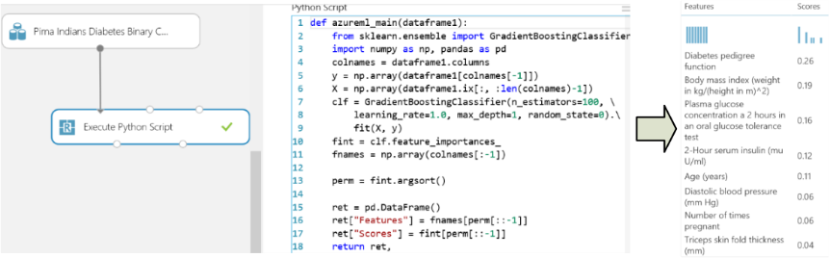
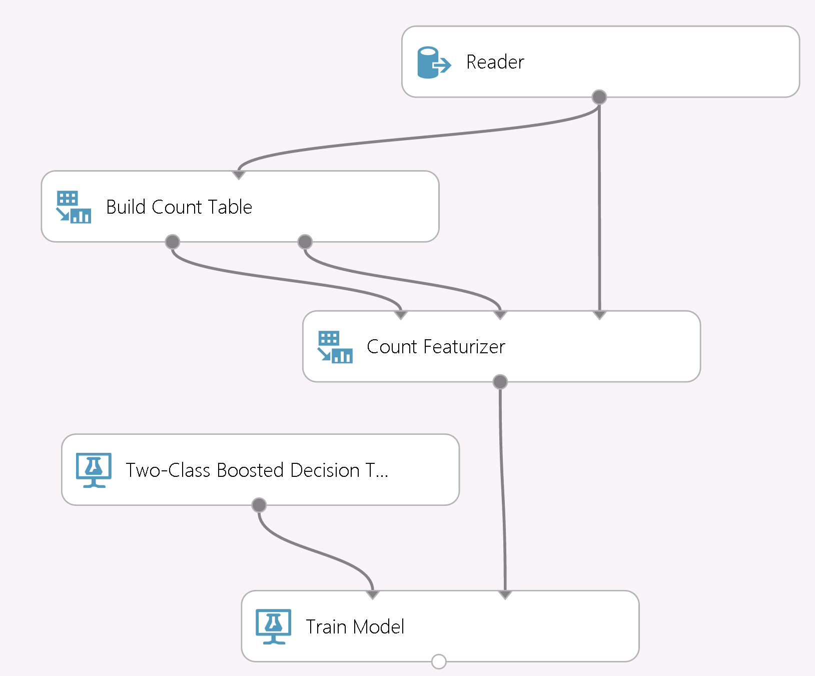
Model Your Way: Open source/our source
Script with R, SQLite or Python
CPython 2.7 support from inside AML Studio
numpy/scipy/panda/scikit-learn/etc.
Anaconda distro pre-installed
Python client library
Analyze data using Python and its libraries
Use IPython, PTVS, Eclipse to edit/debug
Big learning with counts
TB scale datasets
Modular: tune/monitor/replace in isolation
Monitorable and debuggable
Notes:
Our embrace of open source continues with our GA release by now adding to our full support of R with new first class support for SQLite and Python. Just as you can with R, you can drop your custom Python code directly into ML Studio.
You can then combine your custom work with our world-class algorithms such as learning with counts, which allows you to digest terabytes of data – truly a Big Data solution in the cloud.

Slide 16
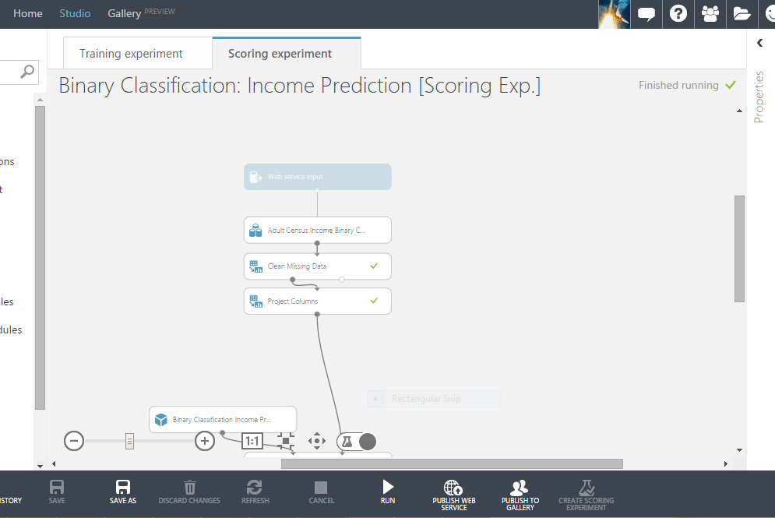
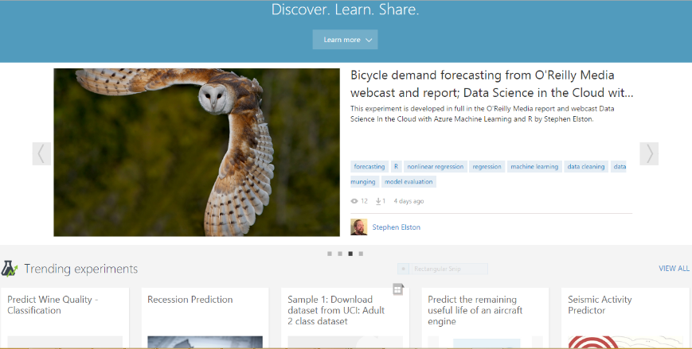
Deploy in Minutes
Expand your Reach
One click to production
Publish as a Web Service or to Gallery
Continuous updates to streamline process Stay tuned to our blog for more
New in-product Gallery
Discover what others have built Learn by dropping these into your workspace
Share your work with others
Notes:
And, as I’ve mentioned, no other vendor offers the ability to deploy with one click – you can literally see the button here. It is simply powerful to be able to put your models into production and increase their usability for businesses, the community and the world.
And we’re enabling the community of Azure ML users by offering an in-product Gallery where you can discover solutions built by others, drop those directly into your workspace for experimentation and learning, as well as easily share your own work in the gallery with the same ease of use you experience with web service production. You can try this out by logging on to azure.com/ml and clicking “get started” to try our perpetually free version.

Slide 17
Personalized offers
Retailer Pier 1 Imports wanted to offer a connected, personal experience both online and in store. Partnering with MAX451 and Microsoft enabled them to launch the One Pier 1 initiative to delight their customers with every interaction.
At Pier 1 Imports, we’ve embraced the cloud. It helps us operationalize technology quickly and react to our ever-evolving business needs.
“
Competitive advantage
Deliver the right message at the best time using the most effective marketing vehicle
Product choices per store and online based on past local and global purchase preference
Business transformation
Seamless customer experience from brick and mortar to online
Leader in omni-channel retailing
”
Andrew Laudato Pier 1 Imports
Notes:
Partnering with MAX451 and Microsoft enabled them to launch the One Pier 1 initiative to delight their customers with every interaction.
Competitive advantage
Deliver the right message at the best time using the most effective marketing vehicle
Product choices per store and online based on past local and global purchase preference
Business transformation
Seamless customer experience from brick and mortar to online
Leader in omni-channel retailing
A vast array of companies can benefit from understanding what they need before they need it and retail customers like Pier 1 are optimizing their marketing down to the individual level across both store and online interactions. Before Azure ML, Pier 1 sent mass emails to all of their customers, advertising the same thing – like outdoor furniture – whether that customer had ever had interest in furniture at all or lived in an applicable place. Today, they’re able to look at past buying behavior, location data and sensor data from their stores to hone in on what will most delight and inspire their customers – and increase their bottom line.
https://www.youtube.com/watch?v=fN8Cixcc5yg&feature=youtu.be
https://customers.microsoft.com/Pages/CustomerStory.aspx?recid=11257

Slide 18
Smart Buildings
The CMU Center for Building Performance and Diagnostics studies the operational efficiency of its buildings worldwide. Before partnering with OSISoft and Microsoft, CMU was challenged to use sensor data for more than reactive repair and diagnosis.
We see Azure ushering in an era of self-service predictive analytics for the masses. We can only imagine the possibilities.
Bertrand Lasternas Carnegie Mellon
“
Competitive advantage
20% savings on energy costs; several hundred thousand dollars campus-wide
Researchers focus on what’s next; technicians fix problems before they start
Business transformation
Scale: same headcount with significantly more reach and impact
”
Notes:
Smart Buildings are the new frontier of optimization for college and business campuses and large buildings like airports and warehouses. Machine Learning allows predictive maintenance of buildings and systems – fixing things before they ever break – and users like Carnegie Mellon are optimizing their heating and cooling across campus for peak and down time and weather patterns. Imagine not heating an entire campus during an unseasonably hot winter day or not cooling it during a Spring cold snap? How much energy and cost would be saved. 20% is what they’re looking at today.
https://customers.microsoft.com/Pages/CustomerStory.aspx?recid=8576
Another example of predictive maintenance is the ThyssenKrupp elevator company, who can now predict elevator issues before they even happen, utilizing the skills of their team in a proactive rather than reactive way.
http://www.microsoft.com/windowsembedded/en-us/internet-of-things-customer-stories.aspx?id=9

Slide 19
Check out finished APIs and solutions or put your own on the Machine Learning marketplace at datamarket.azure.com
Find videos, tutorials on Documentation off azure.com/ml Stay tuned to our blog https://aka.ms/mlblog
Get started for free with only a Microsoft Account ID azure.com/ml

Slide 20
Scenario
THIS IS KARL
Karl owns a company that operates vending machines in Washington state
His job is to make sure that his 100 vending machines are selling drinks and obtaining revenue
Karl wants revenue to always be high and his business to be profitable

Slide 21
Scenario
Sadly, vending machine will occasionally break and may take up to seven days to fix, thus hurting sales
To eliminate this occurrence, Karl must maintain operations
and figure out the best way to utilize resources in order to optimize revenue

Slide 22
Questions and solutions Azure Cloud Services + Machine Learning to the Rescue!
1. Which machines have failed?
2. Which machines will soon fail?
3. How do we plan maintenance?

Slide 23
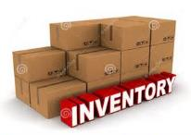
Application phases
CURRENT SCENARIO
REAL-TIME SENSORS
SENSORS AND MACHINE LEARNING
Days:
Days:
Days:
Damage is reported by customer or during weekly restocking routes
Technician must be scheduled to investigate
Process take up to eight days to fixa broken machine
Sensor data is used to monitor cooler condition in real-time
Broken coolers are identified at time of failure
Lost sales remain due to maintenance lead teams (parts and repair technicians)
Azure ML predicts where, when, and what failures will occur based on sensor data
Spare parts and repairs can be scheduled before machines shut down leading to no lost sales

Slide 24

Advanced analytics architecture
Data
Data to model to web services in minutes
Apps, dashboards and processes
API
Cloud
http://studio.azureml.net
Web
HDFS
RDBMS
NoSQL stores
Blobs and tables
ML Studio
Model is now a web svc
Integrated development environment for machine learning
Local
Desktop files
Spreadsheets
Server stores
Sensors
Marketplace
M
Monetize this API
Storage space
Data preparation
Modeling
Deployment
Business value
Data factory
Stream analytics
Machine learning
HDInsight
Marketplace
Azure portal
Power BI
Apps
Notes:
So what does that look like from an architectural perspective? Machine learning is a technology in which you work from business problem backwards. Let’s say I have an issue of customer churn. I don’t know why my best customers are leaving and I need to find out. I have things like Twitter/Facebook/Blog entries in HDInsight – our Hadoop implementation in the cloud – and it’s streaming in daily from the web. On premises I have my customer sales data and buying behavior.
I can then bring in the training set data from HDInsight and a subset of my on-premises customer data into the built-in storage space. I can then model against that training set in ML Studio – which is the playground for the data scientist or advanced analytic developer. In this space the implementer trains and tests the model until she is satisfied that the model will deliver the answer to the question of customer churn. Not only why the customers are departing, but predictive analytics to tell the company which ones are currently at risk based on past data. That way the sales and marketing departments can target those specific customers with the right activities to solve for why they’re leaving in the first place.
The implementer then literally pushes a “Yes” button in the tool to send the finished model into staging, with a flag on the Microsoft Azure portal letting the owner of the all-up portal experience know the model is ready to go. Again – this is a unique and differentiated experience with Azure ML – we are the only ones who offer the ability to push a customized model to production this easily and quickly. Once pushed live, this is now surfaced as a web service which can run over any data, anywhere. If this is running over on-premises data, the data is never persisted in the cloud, so again the only data that must be in the cloud is the original training set, which can be anonymized and removed once the modeling is done for those customers with compliance/security concerns around data in the cloud.
This finished web service can now be called from the company dashboard, where the CMO can easily consume the results and advise the teams accordingly. And, as the company needs change, the implementer need only to revisit the model in ML Studio, adjust it and push it to staging again to literally have the model swap out underneath the live web service.
But what if the company doesn’t have an implementer in house? In that case, they can go right to the Azure Machine Learning Marketplace, where there are live hosted web services already existing to solve common problems such as this. They can be simply hooked up to apps, services and dashboards for this type of solution. This is also a value-add for companies and implementers looking to monetize their own machine learning solutions. Off azure.com/ml on Machine Learning Center we have detailed instructions on how to leverage this to create, monetize and scale your own ML offerings here.

Slide 25
Azure HDInsight
Hadoop in Azure
Support HBase as NoSQL columnar database on Azure Blobs
HBase as a columnar NoSQL transactional database running on Azure Blobs
Storm as a streaming service for near real time processing
Hadoop 2.4 support for 100x query gains on Hive queries
Mahout support for machine learning + Hadoop
Graphical User Interface for HIVE queries
Support Storm as stream processing
HMaster
Coordination
Name Node
Region Server
Region Server
Region Server
Region Server
Job Tracker
Data Node
Data Node
Data Node
Data Node
Task Tracker
Task Tracker
Task Tracker
Task Tracker
HDInsight
Microsoft Confidential – Under Strict NDA
Microsoft Confidential—Subject to NDA. Preliminary Information. Dates and capabilities subject to change. Microsoft makes no warranties, express or implied.
Notes:
Looking back: It’s been a big year for HDInsight, our 100% Apache Hadoop distribution in Azure. HDInsight launched as a Globally Available service on October 2013 (Q2, FY14). From that time there has been major updates including having HDInsight be updated to the latest Hadoop 2.2 clusters and now on Hadoop 2.4 clusters. Microsoft has made major contributions to the Apache open source community through the Stinger project that have improved Hive queries up to 100x faster. This was made possible by taking some of Microsoft’s know-how in SQL Server and translating that into the open source community. Finally, Microsoft continues to add Hadoop sub-projects to HDInsight including Hbase, a columnar NoSQL database as a preview feature and Mahout for a library of Machine Learning.
Looking forward: For FY15, HDInsight will continue its relatively fast release cadence. In Q1, FY15, you’ll see HDInsight release HBase, a columnar NoSQL database as a GA feature. You’ll also see HDInsight arrive in many Azure data centers like Japan, China and Brazil which will give you the ability to sell HDInsight in these regions. In Q2, FY15, you’ll hear about Hortonworks releasing the next version of Hortonworks Data Platform (HDP 2.2) which will have built-in connectors to move data from on-premise to Azure as well as HDInsight being refreshed on this newest version. You’ll also hear about the release of Storm as a streaming service for near real time processing on data in HDInsight.

Slide 26


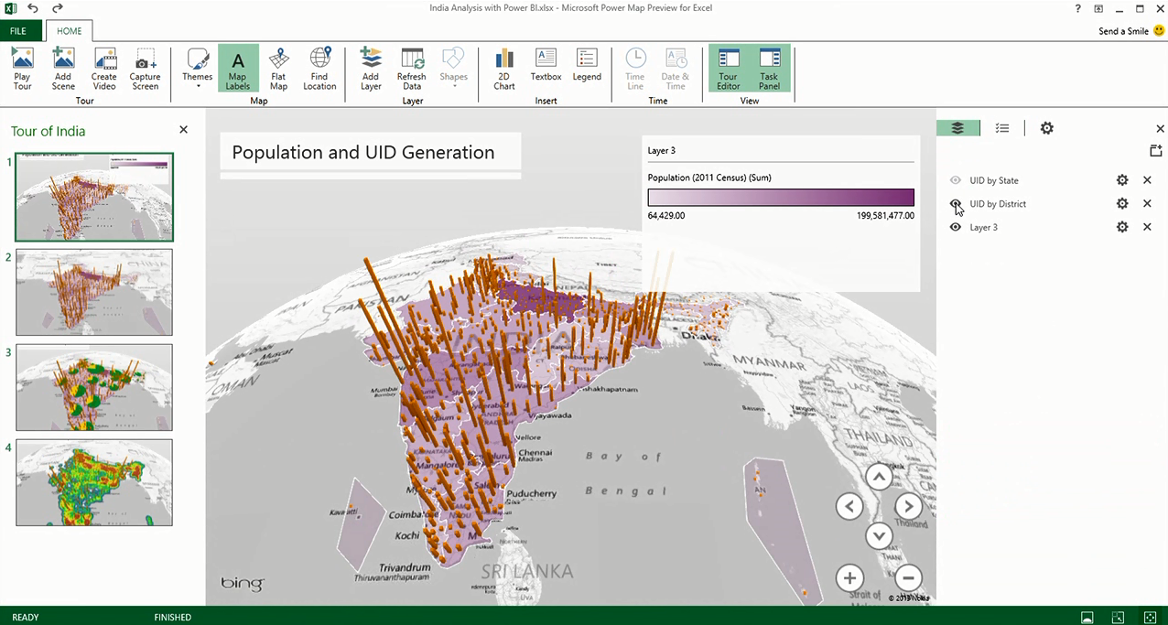

Azure Stream Analytics
Process real-time data in Azure
Consumes millions of real-time events from Event Hub collected from devices, sensors, infrastructure, and applications
Performs time-sensitive analysis using SQL-like language against multiple real-time streams and reference data
Outputs to persistent stores, dashboards or back to devices
Smart Phones
Slates/ Tablets
Servers
ATM
Security
Stream Analytics
POS Terminals
Kinect
PCs/ Laptops
Vending Machines
Specialized Devices
Kiosks
Automation Devices
Digital Signs
Thin Clients
Self Checkout Stations
Handhelds
Point of Service Devices
Diagnostic Equipment
Logic Controllers
Remote Medical Monitors
Microsoft Confidential—Subject to NDA. Preliminary Information. Dates and capabilities subject to change. Microsoft makes no warranties, express or implied.
Notes:
Azure Stream Analytics is a cost effective event processing engine that helps uncover real-time insights from devices, sensors, infrastructure, applications, and data. It will enable various opportunities including Internet of Things (IoT) scenarios such as real-time fleet management or gaining insights from devices like mobile phones and connected cars. Deployed in the Azure cloud, Stream Analytics has elastic scale where resources are efficiently allocated and paid for as requested. Developers are given a rapid development experience where they describe their desired transformations in SQL and the system abstracts the complexities of the parallelization, distributed computing, and error handling from them.
Looking forward into H2 FY15, Stream Analytics will become generally available after previewing at TechEd EMEA 2014.

Slide 27

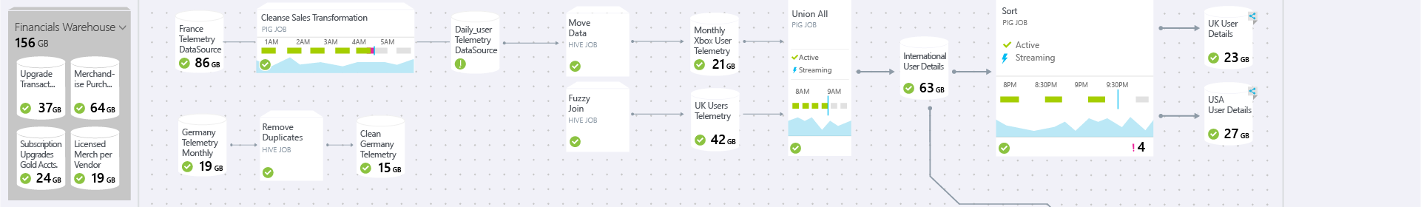
Azure Data Factory
Orchestrate trusted information production in Azure
Connect to relational or non-relational data that is on-premises or in the cloud
Orchestrate data movement & data processing
Publish to Power BI users as a searchable data view
Operationalize (schedule, manage, debug) workflows
Lifecycle management, monitoring
No SQL
Blob
MapReduce
BI & analytics
VM
Hive
Trusted data
DB
Pig
C#
Stored Procedures
Azure Machine Learning
Microsoft Confidential – Under Strict NDA
Microsoft Confidential—Subject to NDA. Preliminary Information. Dates and capabilities subject to change. Microsoft makes no warranties, express or implied.
Notes:
Azure Data Factory is a cloud service for creating, managing, and monitoring the production of trusted information from on-premises and cloud data sources using transformative analytics at scale. Data Factory can be used in solutions to gain insights from operational and service health telemetry data, analyze customer actions to determine an optimal targeted marketing strategy, or predict customer churn from customer profile and service log data. Instead of writing hard-to-manage custom code to wire together a data warehouse with Hadoop, NoSQL, and SaaS, use Data Factory to quickly create and deploy highly available data processing pipelines, significantly cutting your time to solution and your operational costs. Get a single monitoring view of all of your data processing pipelines along with data lineage and service health. Bring together on-premises data like SQL Server and cloud data like Azure SQL Database, Blobs, and Tables with the transformative analytics of HDInsight (Hive, Pig, MapReduce, custom .NET code), and even Azure Machine Learning, to produce trusted information that is easily consumed by BI tools or applications.
Looking forward into H2 FY15, Data Factory will become generally available after previewing at TechEd EMEA 2014.

Slide 28
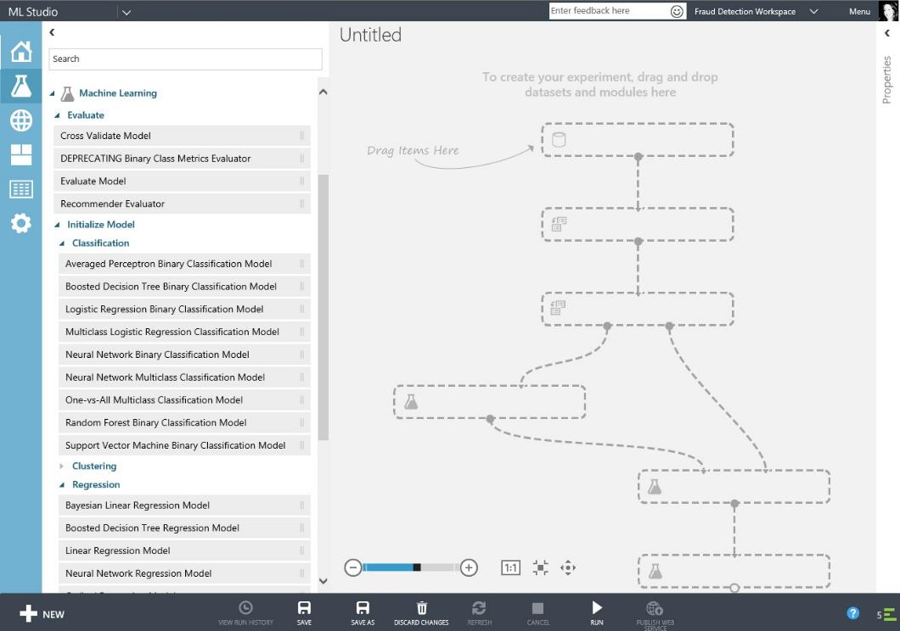

Azure Machine Learning
Beyond business intelligence – machine intelligence
Get started with just a browser Requires no provisioning; simply log on to your Azure subscription or try it for free off azure.com/ml
Experience the power of choice Choose from hundreds of algorithms and packages from R and Python or drop in your own custom code
Take advantage of business-tested algorithms from Xbox and Bing
Deploy solutions in minutes With the click of a button, deploy the finished model as a web service that can connect to any data, anywhere
Connect to the world Brand and monetize solutions on our global Machine Learning Marketplace https://datamarket.azure.com/
Microsoft Azure Machine Learning Studio
Modeling environment (shown)
Microsoft Azure Machine Learning API service
Model in production as a web service
Microsoft Azure Machine Learning Marketplace
APIs and solutions for broad use
Microsoft Confidential—Subject to NDA. Preliminary Information. Dates and capabilities subject to change. Microsoft makes no warranties, express or implied.
Notes:
Microsoft’s Big Data vision in the cloud is to enable organizations to solve large, complex problems end-to-end, from storing and managing TBs of data without investing in hardware and software, to seamless integration with the 1 billion users of Excel. As part of this vision, Microsoft offers Azure Machine Learning, designed to democratize the complex task of advanced analytics.
Advanced analytics is using products like Azure Machine Learning to find new and actionable insights that traditional approaches to business intelligence are unlikely to discover. An easy way to think about this is thinking about a dashboard. Today when confined by only BI tools without a connection to machine learning, it is solely the job of the human looking at the spreadsheet to gain insights and react to the data. But a human can only consume so many variables. A computer, on the other hand, can consume a great deal more variables to provide much deeper insight on the data. Humans can then react to the data to make decisions that drive competitive advantage, as well as program the computer further to recognize important patterns in the future. This is why we say beyond business intelligence – machine intelligence.
The accessibility of our solution starts with set up. Previously you needed to provision your workspace on-premises for machine learning, also thinking about server space and a host of other considerations. Today you can get started with just a browser. With only an Azure subscription, you can take advantage of the full functionality of Azure Machine Learning within minutes. Taking a test drive is even easier, click Get Started off azure.com/ml and with simply a Microsoft ID you’re off to the races.
Another limit with other machine learning solutions are siloed environments that only allow for one programming language or make changing from one algorithm to another time consuming and complex. With Azure ML, you can experience the power of choice. That choice expands to language, with both Python and R being first class citizens of Azure ML, or algorithm. You can choose from hundreds of algorithms, including business-tested ones running our Microsoft businesses today. And swapping out algorithms to land on the right one for you is done with a click. Additionally you can drop in custom R and Python code – your “special sauce” – and mix and match that with the other options in the tool.
Most revolutionary of all you can deploy solutions in minutes as a web service, which is simply a url which can connect to any data, anywhere – including on-premises or in another cloud environment. The ability to put a model into production almost immediately, as well as revise it easily, is unique to Microsoft and allows companies to stay on top of the changing business landscape more effectively than is offered by any other provider today.
We even take that a step further, allowing model developers to connect to the world with our Machine Learning Marketplace, where they can publish finished solutions and APIs with their own brand and business model. Developers can also discover machine learning solutions there without any machine learning skills needed – the data science is inside. Check it out at https://datamarket.azure.com/.

Slide 29
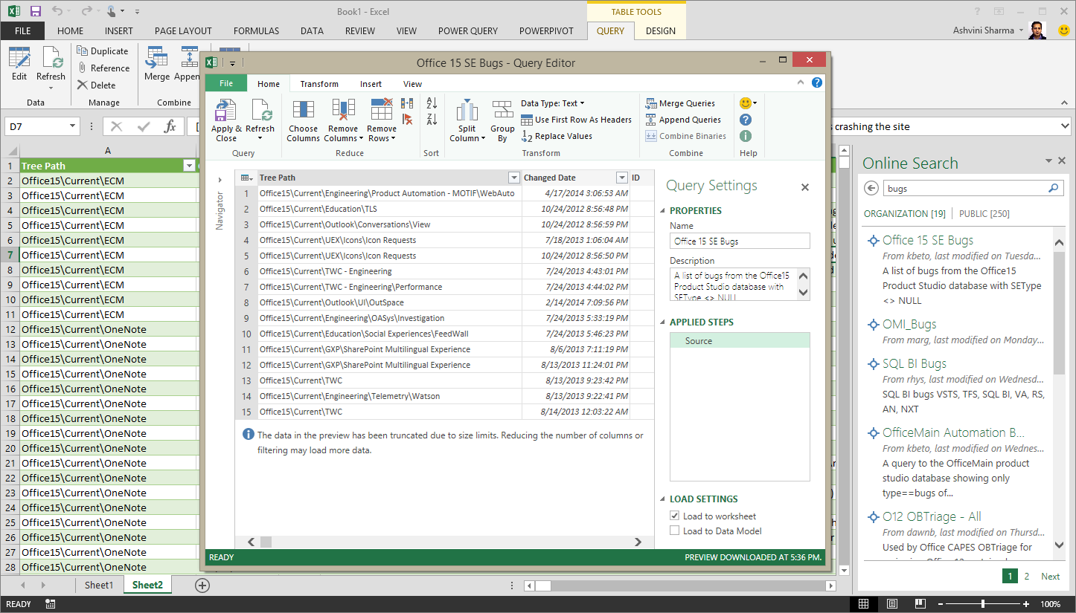
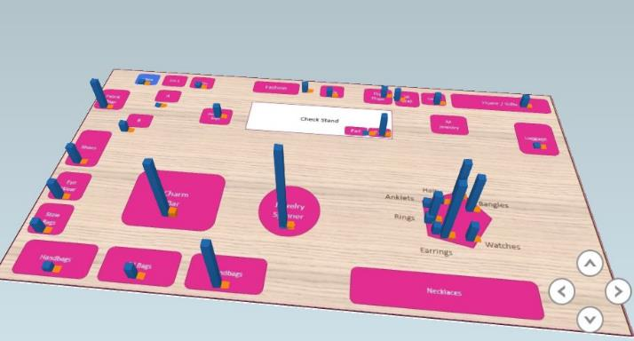
Excel BI Investments
Power Map with custom maps allows deeper geospatial explorations and storytelling
Power Query brings modern data discovery, connectivity, shaping and publishing to Excel
Analysis Services connectivity for Power View allows users to leverage existing IT investments
Support for more sophisticated data models in Power Pivot – date and calc tables, many-to-many relationships, etc
Power Query
Power Map w/ Custom Maps
Microsoft Confidential—Preliminary Information. Dates and capabilities subject to change. Microsoft makes no warranties, express or implied.
Notes:
Areas of investment for BI in Excel:
Filtering for Power Map:
Available Sept 2014: With filtering in Power Map, use familiar Excel filter controls to uncover more insights from your 3D geospacial visualizations. When using filters, you can adjust the amount of data shown, toggle between different categories or simply search and select specific values for more targeted analyses.
Custom Maps for Power Map:
Available Sept 2014: Custom Maps extends all the features of Power Map so you can tell rich and interactive stories using any map type. Simply choose an image – like building floor maps, the human body, public transit routes, and system architectures - and Excel will guide you through transforming your data into visualizations that can be explored and shared.
OLAP Connectivity within Power View:
Connect Power View in Excel to an external Analysis Services model without the need to import the data into Excel.
Richer Data Models with Power Pivot:
We are enhancing Power Pivot to enable you to create and analyze richer data models, like calculated tables and many-to-many relationships. The relationship between your business data can be complex and Power Pivot, with more powerful data modeling capabilities, allows you to analyze that data effectively to uncover deeper insights that will boost your competitive edge.
Deeper Integration of BI in Excel:
Power BI for Office 365 adds value to your businesses because it makes BI accessible to your entire team through the familiarity of Excel. The Power BI features in Excel will be integrated more deeply to make it even easier for any business user to discover and start benefiting from the collective intelligence of your business community.

Slide 30
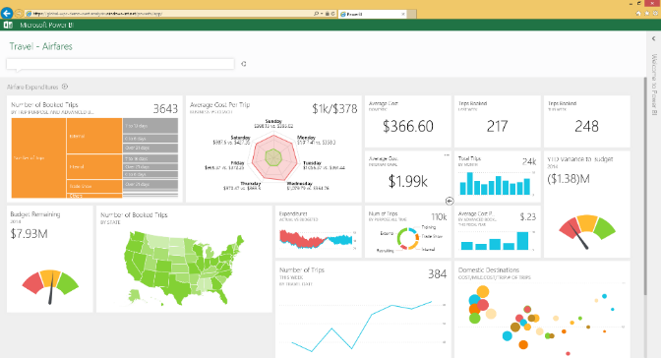
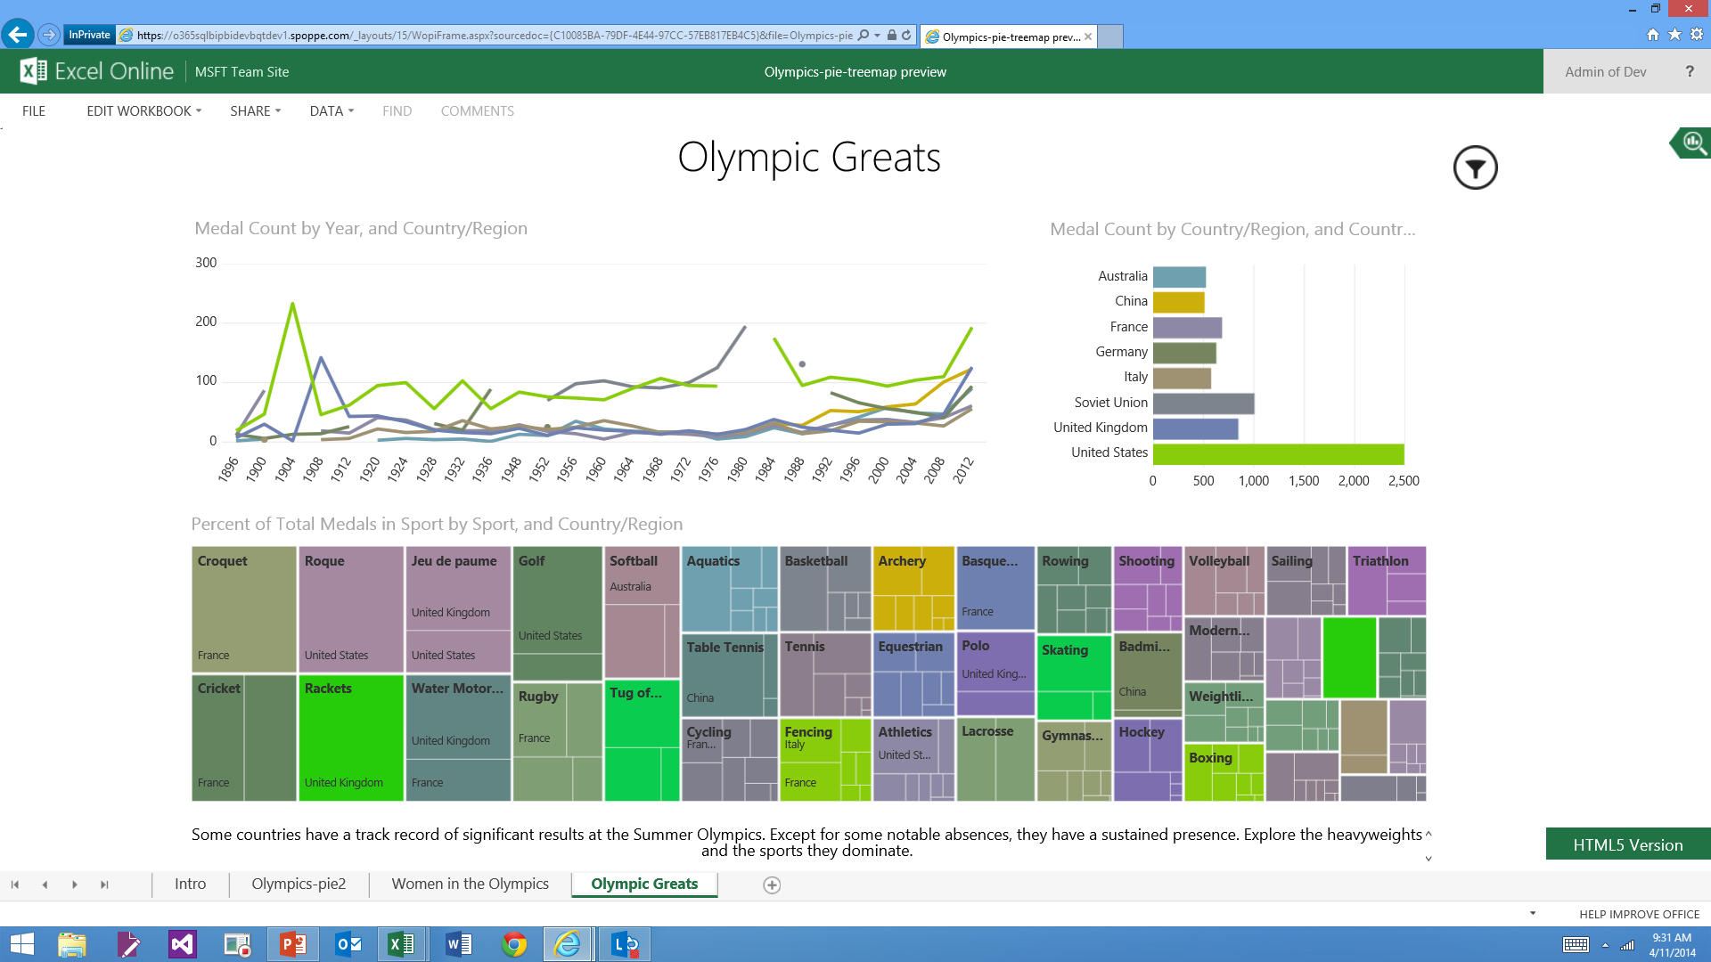
Power BI investments
Power BI dashboards and KPIs for monitoring the health of your business
New data visualizations and touch-optimized exploration in HTML5
Power BI mobile apps across devices including iPad and iPhone
Support for new data sources including SalesForce.com, Dynamics CRM online and SQL Server Analysis Services
Dashboard
Tree Map
Microsoft Confidential—Preliminary Information. Dates and capabilities subject to change. Microsoft makes no warranties, express or implied.
Notes:
Areas of investment for Power BI
Power BI dashboards and KPIs – Power BI will provide new capabilities to allow for the creation of live dashboards and easy to create KPIs that can be pinned to the dashboard - from which you can drill into underlying Power View reports for additional detail and data exploration.
New data visualizations – we will introduce a host of new data visualizations for Power BI. eg. Tree Map.
Touch optimized data exploration in Power View HTML5 – Power View will gain new touch optimized data exploration features allowing users to explore data more easily on touch devices.
Power BI mobile applications – beyond the mobile experiences provide through HTML5 we also continue to invest in providing native mobile apps and will soon support both iPad and iPhone.
Support for new data sources such as SalesForce.com and Dynamics CRM – new data sources will be added such as SalesFoce.com and tighter integration with CRM online.
Support for SQL Server Analysis Services –
Power Query will support SQL Server Analysis Services as a data source.
Power BI will also support interactive query directly to SQL Server Analysis services on-premises. This will be to both tabular and multidimensional cubes. This will allow organizations to managing and maintain their existing Analysis Services models without having to move their data to the cloud. Users will be able to view and explore their data from Power View in Power BI and the system will directly connect and query against SQL Server Analysis Service on-premises.

